Slide 1

SQL Injection
How it works
Parameter Substitution
Notes:
In this lesson we are going to talk about SQL injection. You have to be careful when you substitute user input into your SQL statements. If you aren’t then a sneaky user can run amuck through your database tables.
We’ll see what SQL injection is and how it works. Then we’ll see how to avoid it with proper parameter substitution.

Slide 2

See Also
https://stackoverflow.com/questions/902408/how-to-use-variables-in-sql-statement-in-python
https://docs.python.org/3/library/sqlite3.html
Notes:
Here is some additional reading on the web.

Slide 3

Table of User Logins
CREATE TABLE USERS (
name VARCHAR(20),
pass VARCHAR(20)
);
INSERT INTO USERS values ('Admin', 'secret’);
INSERT INTO USERS values ('Chris', 'topher’);
INSERT INTO USERS values ('Pat', '12345');
Name | Password
Admin | secret
Chris | topher
Pat | 12345
Notes:
The bank loves your ATM code and they want you to write a python application for all the bank employees to use.
Different users have different roles. They will log in to the application with their username and password. You crank up a quick table in the database like this one.
#1 Let’s call the table USERS
#2 The username is a string up to 20 characters
#3 So is the password
Yes, there is much more to do here. Do we need a primary key – maybe a user id? Or maybe the username is the primary key and we a constraint to enforce uniqueness.
Password are required. So are usernames. These are constraints we could and should add. But lets keep the example simple.
#4 Lets add an admin user. This user can do all kinds of important things that most other users can’t.
#5 Add an entry for Chris
#6 And one for Pat
Pretty easy stuff.

Slide 4
Check Login
select * from users where name='Admin' AND pass='jj'
Username:
Admin
Password:
jj
Notes:
Now lets think about the login process. The user will get a simple prompt like this one.
#1 I’ll try to log in as ADMIN
#2 Password “jj”, which isn’t correct
How do we check the username and password against our database table?
#3 Maybe something like this. We’ll end up with a simple select – select rows from table USERS (all columns) where the name and password match.
#4 We’ll take the username input and drop it into our SQL
#5 Same with the password
Does this username and password match a row in the table? No. We get back zero rows.
The username is unique – we will get around to writing that constraint. But if the username and password matches a row then we get back a row and the login was a success.

Slide 5
Python Code
import sqlite3
conn = sqlite3.connect("grades.sqlite")
c = conn.cursor()
name = 'Chris'
password = 'topher'
c.execute("select * from users where name='"+name+"' and pass='"+password+"'")
user = c.fetchone()
print(user)
conn.close()
(u'Chris', u'topher’)
None
Notes:
Let’s write the code.
#1 No surprise. We get a connection … #2 and a cursor object
#3 We need the name and password from the login form. I’ll just hard code it here for the example.
#4 Execute the select. Most of the string is our hardcoded SQL. But we splice in name and password with the plus operator.
#5 Fetch one row from the results.
#6 Print the row … #7 username and password were correct – I got the one row
If the password had been wrong I would get back the builtin “None”
#8 Like this
Seems pretty straight forward! What could go wrong here?

Slide 6
SQL Injection
select * from users where name=' ' AND pass=' '
name = "Bobby"
password = "' or ''='' --"
Username:
Bobby
Password:
' or ''='' --
(u'Admin', u'secret')
TRUE
select * from users where name='Bobby' AND pass='' or ''='' --'
Matches ALL rows
First happened to be “Admin”
A AND B OR 1
comment
Notes:
Well, here comes Micha – the 10 year old super-hacker from California. He doesn’t have a login at the bank. But that’s not going to stop him from getting in!
#1 He puts in the username BOBBY.
#2 We know there is no username BOBBY in our table. You are out of luck, kid!
#3 This is the password he puts in. Tick mark, space, OR, space, two tickmarks, and equal, two more tickmarks, a space, and two dashes. What kind of crazy password is that?
#4 our code takes his password and substitutes it in.
#5 Here are our variables – name and password – filled with the raw input from the login form
#6 What gets printed on the screen? Big fat “None”, right? #6 wait. Micha just logged in as admin. He used a non-existent name and a crazy password. What’s going on here?
#7 Lets look at the SQL passed to the database
What does the database see? #8 it sees a select with a complicated WHERE clause. It takes the rows one by one – is name BOBBY and password empty string? OR does empty string equal to empty string?
#8 this is always true for every row the DB checks. Empty always equals empty.
#9 See this little dangling tick mark in our string up here? Notice how the double dash comments out the remainder of the string.
#10 Here is the Boolean expression the database works with. A AND B. We know that is always false in our table. Then that false Ored with TRUE. False Ored with TRUE is always one. This where clause always passes.
#11 This SQL matches every row
Our code pulls the very first row from the result set
#12 Fortunately for our hacker, the first row is the ADMINISTRATOR
Micha was able to inject some fragments of SQL directly into our select statement. Thus we call this kind of attack “SQL Injection”, and it has been surprisingly successful over the years!
Our code seems straight forward and simple. Where did we go wrong? How can we prevent SQL injections?

Slide 7

Sanitize
Always sanitize raw inputs to your program
Text field entries, prompts, data-files
Parameters coming in through a web request
Built into the database library
Notes:
We messed up by blindly splicing in the user’s input.
ALWAYS sanitize raw input to your program to make sure nothing dangerous gets in by mistake.
#1 Some common things to check are TEXT FIELD entries, prompts the user responds to, and data files that your program read in.
#2 A big one is parameters coming in through a web request. Remember users can use free tools like POSTMAN to craft whatever requests they want. Your server code must check everything!
#3 The good news about SQL is that this sanitization is built into the library. You just have to know how to use it, which is why you are here.

Slide 8
Sanitize
import sqlite3
conn = sqlite3.connect("grades.sqlite")
conn.execute('pragma foreign_keys=ON')
c = conn.cursor()
name = 'Chris'
password = 'topher'
c.execute("select * from users where name=? and pass=?",(name,password))
user = c.fetchone()
print(user)
name = 'Bobby'
password = "' or ''='' --"
c.execute("select * from users where name=? and pass=?",(name,password))
user = c.fetchone()
print(user)
conn.close()
(u'Chris', u'topher’)
None
Notes:
Here is how it works. Here is our code again. This time I’ll put the pragma in there as a reminder. I should have been doing this all along. I might leave it out to keep the examples short, but remember it is there!
OK. Here is the name and password and we are ready to execute the select statement. Instead of building the string myself I’ll let the database library fill things in. Like this:
#1 I pass in one string and one tuple – the values I want to substitute. The question marks are the spots where the substitutions go. The library parses my string from left to right and fills in the question marks from the tuple left to right. But the library sanitizes the inputs. It removes tick marks and comments and such. I don’t have to worry about SQL injection.
Notice that the driver inserts the tick marks around strings! If your value in the tuple is a string then you get tick marks. If it is a number you don’t – which is exactly what you want.
#2 Print the user … CHRIS and TOPHER is a valid row
#3 There it is on the screen
#4 Now to try the same SQL injection
#5 Let the library fill in the values – and sanitize them
#6 This time nothing matched as I expected

Slide 9
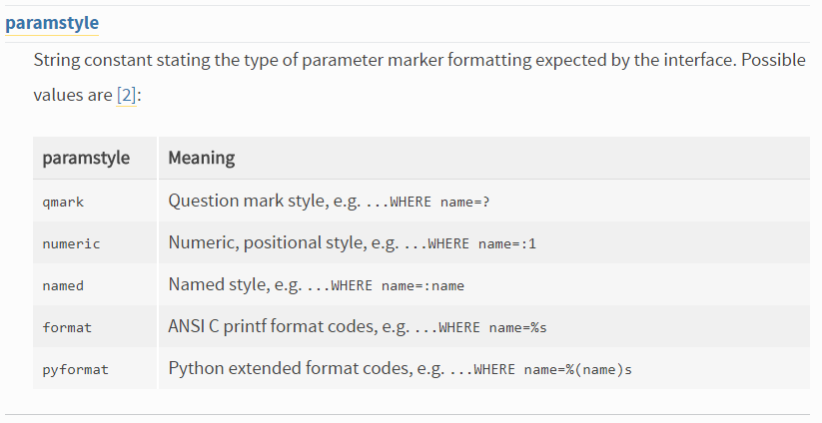
Sanitize
Database providers use different substitution schemes
You can ask the driver what it uses:
print( sqlite3.paramstyle )
qmark
Notes:
Before you go commit USE QUESTIONMARKS to memory, please note that different databases might use different substitution tokens.
#1 How do you know what to use? You can ask the database driver
#2 print the value of “paramstyle”
#3 For SQL lite the style is “qmark” – use a question mark
#4 Here are the possible values
The qmark seems the easiest. But there is also the PERCENT formatters like %s and %d. This allows you to specify the data type like string or number. You don’t have to rely on the runtime type of the value in the tuple.

Slide 10
Tuples of One
c.execute( "select * from users where name=?",name )
“Chris”
Traceback (most recent call last):
File "C:\Users\tophe\git\class-AdvancedPython\03_Database\Injection.py", line 53, in <module>
c.execute("select * from users where name=?",name)
sqlite3.ProgrammingError: Incorrect number of bindings supplied. The current statement uses 1, and there are 5 supplied.
c.execute( "select * from users where name=?",(name) )
Expression like (1+2)
Traceback (most recent call last):
File "C:\Users\tophe\git\class-AdvancedPython\03_Database\Injection.py", line 53, in <module>
c.execute("select * from users where name=?",name)
sqlite3.ProgrammingError: Incorrect number of bindings supplied. The current statement uses 1, and there are 5 supplied.
c.execute( "select * from users where name=?", (name,) )
Tuple of one thing
Notes:
Remember that this substitution value is a TUPLE – a list of things. Even if you have just one thing.
Here I am just substituting in the name.
#1 But I get an error from the driver. It wanted ONE value for the second parameter. Instead it got 5. Five?
#2 It took each letter as a separate thing to substitute.
#3 Let’s try again but make a tuple by wrapping it in parenthesis.
#4 Same error. That looks like a tuple, but really it is a regular old expression like before.
#5 You can sprinkle parenthesis throughout an expression. You usually find them in math expressions, but they work for strings as we have here.
#6 This is how you make a tuple of one thing. The parenthesis and comma tell Python that this is a tuple and not an expression.
#7 Since there is only one value – nothing after the comma – you get a tuple of one thing.

Slide 11

Tinkering
Rework the “grades” examples to use parameter substitution.
Do a web search to find the parameter schemes used by:
MYSql
Postgres
Oracle
Notes:
Here are some things to try on your own. These are totally optional – there is nothing for you to send to me.
Try reworking our “grades” code example to use parameter substitution instead of string appends.
We know sqlite3 uses the question-mark (qmark) substitution style. Do a web search to find out what some other database use.
SQL Injection. This is a fun topic and very timely with all the cyber security in the news.
Send me email if you have questions or comments.
See you next time.

